Slide 1
Exploratory Data Analysis Unit -1
Dr Latesh Malik

Slide 2
Outline
Elements of Structured Data
Regular Data
Estimation of Location, Variability
Data distribution
Binary & Categorical Data
Correlation

Slide 3
Topics Today and Next Time
Exploratory Data Analysis
Data Diagnosis
Graphical/Visual Methods
Data Transformation
Confirmatory Data Analysis
Statistical Hypothesis Testing
Graphical Inference

Slide 4
Descriptive vs. Inferential
Descriptive: e.g., Mean; describes data you have but can't be generalized beyond that
Inferential: e.g., t-test, that enable inferences about the population beyond our data

Slide 5
Examples of Business Questions
Simple (descriptive) Stats
“Who are the most profitable customers?”
Hypothesis Testing
“Is there a difference in value to the company of these customers?”
Segmentation/Classification
What are the common characteristics of these customers?
Prediction
Will this new customer become a profitable customer? If so, how profitable?
adapted from Provost and Fawcett, “Data Science for Business”

Slide 6
Applying techniques
What models/techniques to use depends on the problem context, data and underlying assumptions.
e.g., Classification problem with binary outcome? -> logistic regression, Naïve Bayes, …
e.g., Classification problem but no labels?
-> Perhaps use K-means clustering

Slide 7
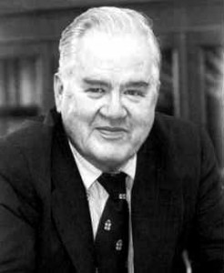
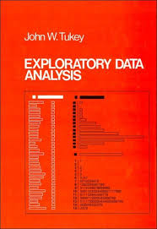
Exploratory Data Analysis 1977
Based on insights developed at Bell Labs in the 60’s
Techniques for visualizing and summarizing data
What can the data tell us? (in contrast to “confirmatory” data analysis)
Introduced many basic techniques:
5-number summary, box plots, stem and leaf diagrams,…
5 Number summary:
extremes (min and max)
median & quartiles
More robust to skewed & longtailed distributions

Slide 8
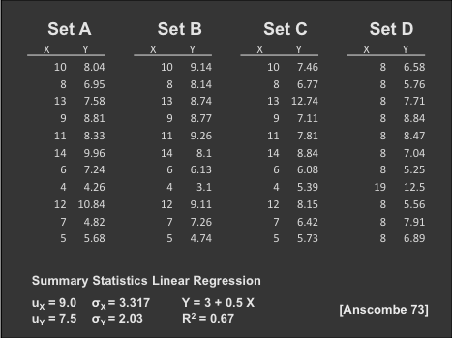
The Trouble with Summary Stats

Slide 9
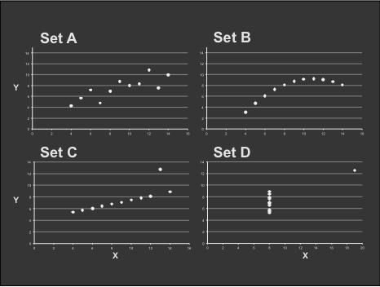
Looking at Data

Slide 10
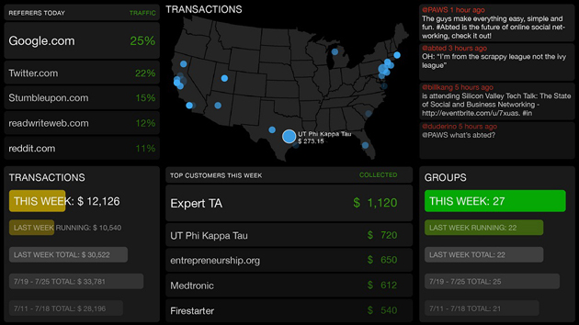
Data Presentation
Dashboard

Slide 11

Data Presentation
Data Art

Slide 12
Chart types
Single variable
Dot plot
Jitter plot
Box plot
Histogram
Kernel density estimate
Cumulative distribution function
(note: examples using qplot library from R)
Chart examples from Jeff Hammerbacher’s 2012 CS194 class

Slide 13

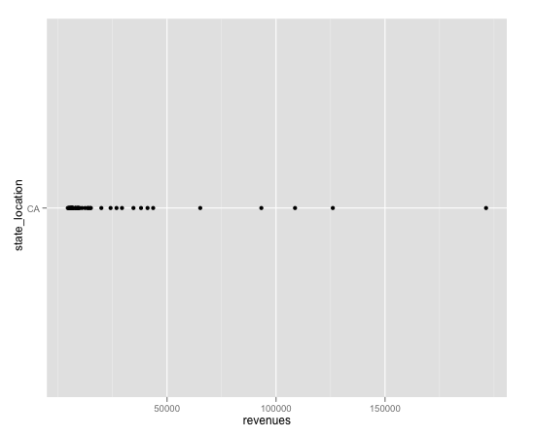
Chart types
Dot plot

Slide 14
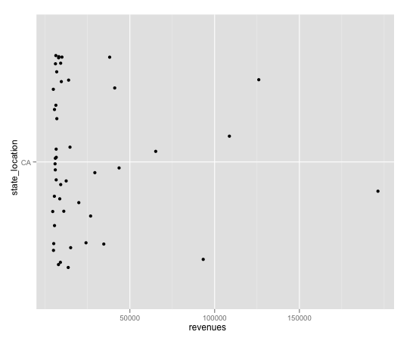
Chart types
Jitter plot

Slide 15
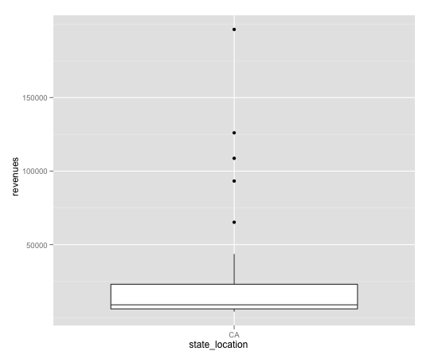
Chart types
Box plot

Slide 16
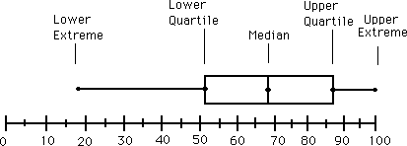
Chart types
Box plot

Slide 17
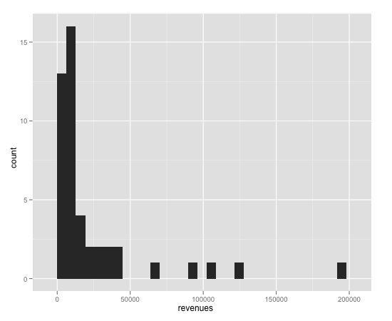
Chart types
Histogram

Slide 18
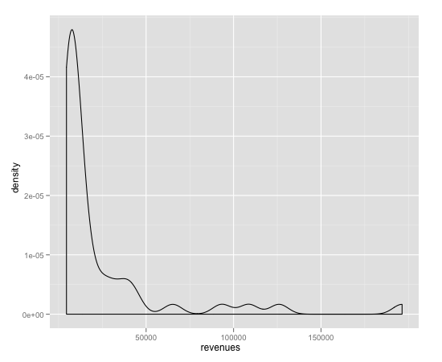
Chart types
Kernel density estimate

Slide 19
Chart types
Histogram and Kernel Density Estimates
Histogram
Proper selection of bin width is important
Outliers should be discarded
KDE
Kernel function
Box, Epanechnikov, Gaussian
Kernel bandwidth

Slide 20
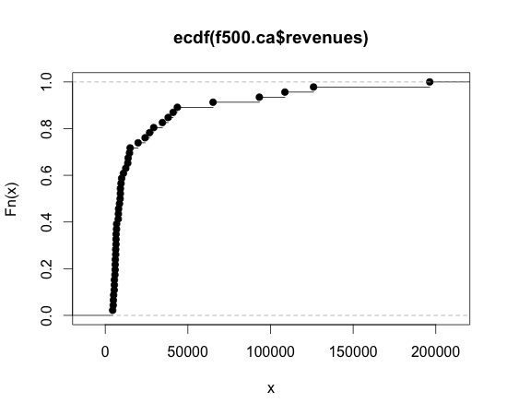
Chart types
Cumulative distribution function

Slide 21
Chart types
Two variables
Scatter plot
Line plot
Log-log plot
Cut-and-stack plot
Pairs plot

Slide 22
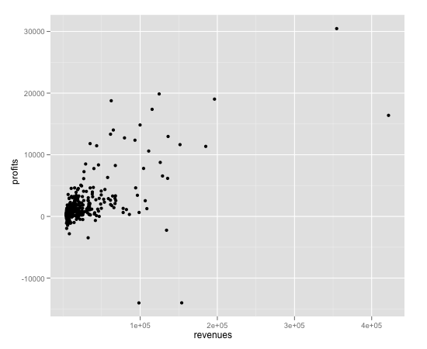
Chart types
Scatter plot

Slide 23
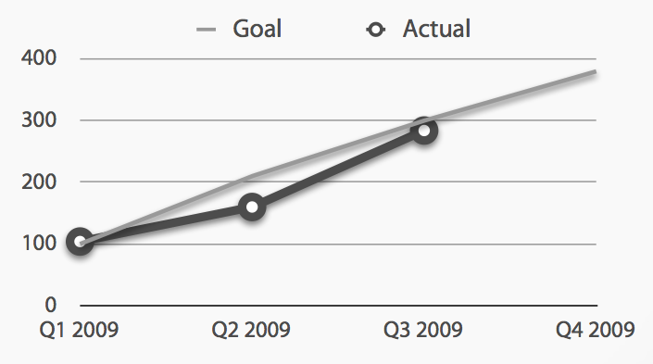
Chart types
Line plot

Slide 24
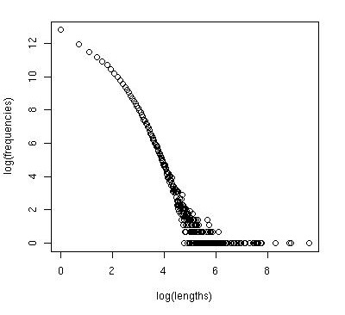
Chart types
Log-log plot

Slide 25
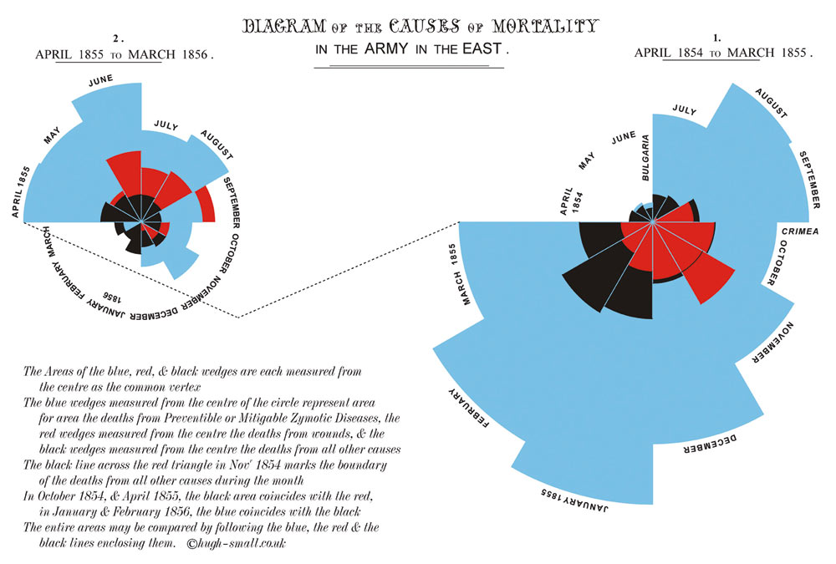
Chart types
Coxcomb plot
Notes:
Atrributed to Florence Nightingale

Slide 26
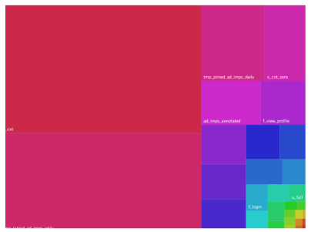
Chart types
Treemap

Slide 27
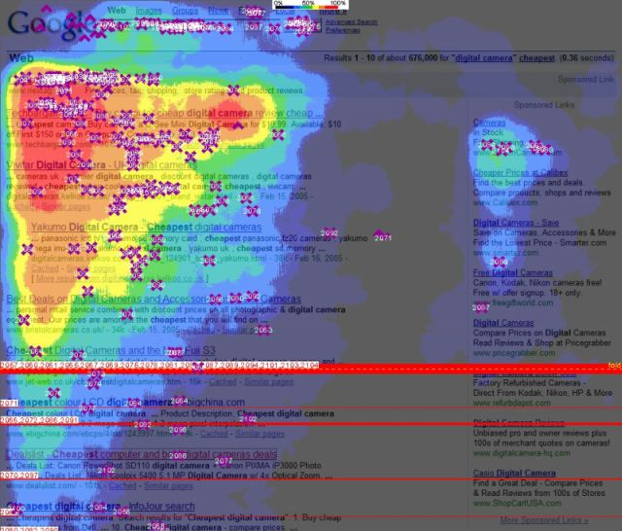
Chart types
Heatmap

Slide 28
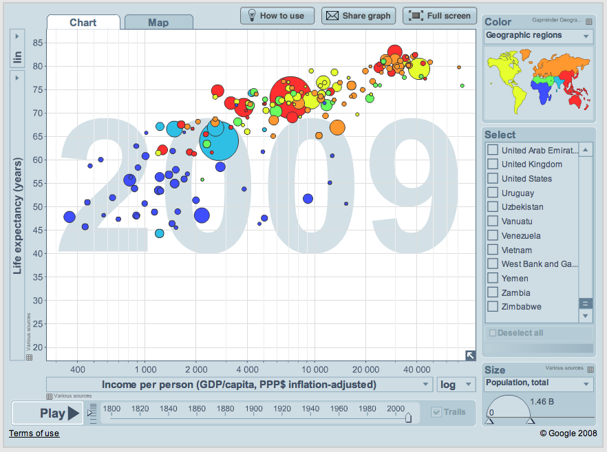
Chart types
Gapminder

Slide 29
The Need for Models
“All models are wrong, but some models are useful.” George Box
Data represents the traces of the real-world processes.
Two sources of randomness and uncertainty:
1) those underlying the process themselves
2) those associated with the data collection methods
To simplify the traces into something more comprehensible you need:
mathematical models or functions of the data -> Statistical estimators

Slide 30
More on Models
N is size of population
n is sample size (subset of the population)
Getting the subset (i.e. sampling) can introduce "bias" leading to incorrect conclusions

Slide 31
Probability Distributions
Natural processes tend to generate measurements whose empirical shape could be approximated by mathematical functions with a few parameters that could be estimated from the data.

Slide 32
Structured Data
Structured data is the data which conforms to a data model, has a well define structure, follows a consistent order and can be easily accessed and used by a person or a computer program.

Slide 33
Characteristics
Data conforms to a data model and has easily identifiable structure
Data is stored in the form of rows and columns Example : Database
Data is well organised so, Definition, Format and Meaning of data is explicitly known
Data resides in fixed fields within a record or file
Similar entities are grouped together to form relations or classes
Entities in the same group have same attributes
Easy to access and query, So data can be easily used by other programs
Data elements are addressable, so efficient to analyse and process

Slide 34
Sources of Structured Data
SQL Databases
Spreadsheets such as Excel
OLTP Systems
Online forms
Sensors such as GPS or RFID tags
Network and Web server logs
Medical devices

Slide 35
Advantages of Structured Data
Structured data have a well defined structure that helps in easy storage and access of data
Data can be indexed based on text string as well as attributes. This makes search operation hassle-free
Data mining is easy i.e knowledge can be easily extracted from data
Operations such as Updating and deleting is easy due to well structured form of data
Business Intelligence operations such as Data warehousing can be easily undertaken
Easily scalable in case there is an increment of data
Ensuring security to data is easy

Slide 36
Difference between Big Data and Traditional Data
Data size
How the data is organized
Infrastructure required to manage data
Source
Way of analyzing data

Slide 37
Traditional Data | Big Data
Traditional data is generated in enterprise level. | Big data is generated outside the enterprise level.
Its volume ranges from Gigabytes to Terabytes. | Its volume ranges from Petabytes to Zettabytes or Exabytes.
Traditional database system deals with structured data. | Big data system deals with structured, semi-structured,database, and unstructured data.
Traditional data is generated per hour or per day or more. | But big data is generated more frequently mainly per seconds.
Traditional data source is centralized and it is managed in centralized form. | Big data source is distributed and it is managed in distributed form.
Data integration is very easy. | Data integration is very difficult.
Normal system configuration is capable to process traditional data. | High system configuration is required to process big data.

Slide 38
The size of the data is very small. | The size is more than the traditional data size.
Traditional data base tools are required to perform any data base operation. | Special kind of data base tools are required to perform any databaseschema-based operation.
Normal functions can manipulate data. | Special kind of functions can manipulate data.
Its data model is strict schema based and it is static. | Its data model is a flat schema based and it is dynamic.
Traditional data is stable and inter relationship. | Big data is not stable and unknown relationship.
Traditional data is in manageable volume. | Big data is in huge volume which becomes unmanageable.
It is easy to manage and manipulate the data. | It is difficult to manage and manipulate the data.
Its data sources includes ERP transaction data, CRM transaction data, financial data, organizational data, web transaction data etc.

Slide 39
Estimation of Variability

Slide 40
Variability
The goal for variability is to obtain a measure of how spread out the scores are in a distribution.
A measure of variability usually accompanies a measure of central tendency as basic descriptive statistics for a set of scores.

Slide 41
Central Tendency and Variability
Central tendency describes the central point of the distribution, and variability describes how the scores are scattered around that central point.
Together, central tendency and variability are the two primary values that are used to describe a distribution of scores.

Slide 42
Variability
Variability serves both as a descriptive measure and as an important component of most inferential statistics.
As a descriptive statistic, variability measures the degree to which the scores are spread out or clustered together in a distribution.
In the context of inferential statistics, variability provides a measure of how accurately any individual score or sample represents the entire population.

Slide 43
Variability (cont.)
When the population variability is small, all of the scores are clustered close together and any individual score or sample will necessarily provide a good representation of the entire set.
On the other hand, when variability is large and scores are widely spread, it is easy for one or two extreme scores to give a distorted picture of the general population.

Slide 44
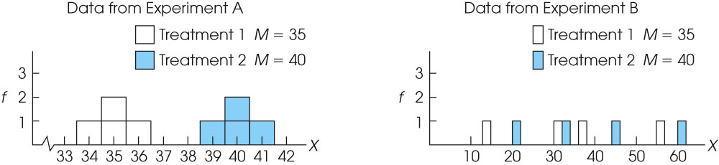
Notes:
Figure 4.9
Graphs showing the results from two experiments. In Experiment A, the variability is small and it is easy to see the 5-point mean difference between the two treatments. In Experiment B, however, the 5-point mean difference between treatments is obscured by the large variability.

Slide 45
Measuring Variability
Variability can be measured with
the range
the interquartile range
the standard deviation/variance.
In each case, variability is determined by measuring distance.

Slide 46
The Range
The range is the total distance covered by the distribution, from the highest score to the lowest score (using the upper and lower real limits of the range).

Slide 47
The Interquartile Range
The interquartile range is the distance covered by the middle 50% of the distribution (the difference between Q1 and Q3).

Slide 48
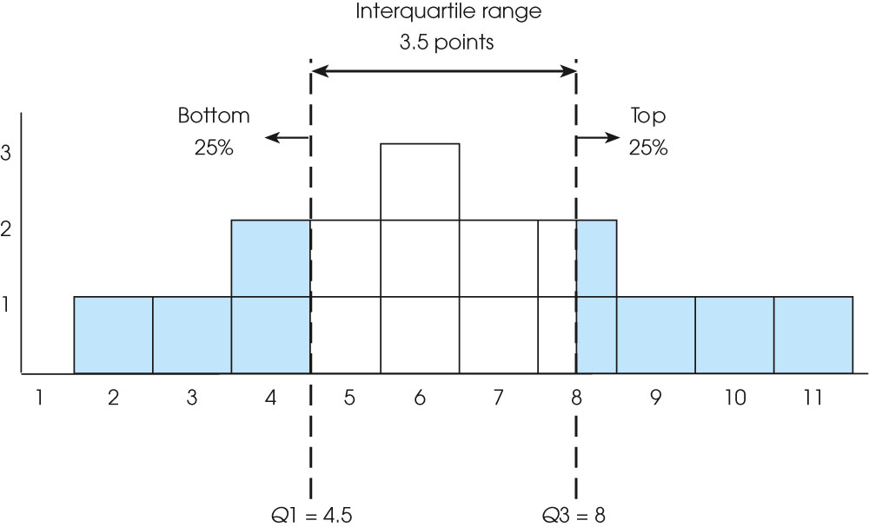
Notes:
Figure 4.2
Frequency distribution for a population of N = 16 scores. The first quartile is Q1 = 4.5. The third quartile is Q3 = 8.0. The interquartile range is 3.5 points. Note that the third quartile (Q3) divides the two boxes at X = 8 exactly in half, so that a total of 4 boxes are above Q3 and 12 boxes are below it.

Slide 49
The Standard Deviation
Standard deviation measures the standard distance between a score and the mean.
The calculation of standard deviation can be summarized as a four-step process:

Slide 50
The Standard Deviation (cont.)
1. Compute the deviation (distance from the mean) for each score.
2. Square each deviation.
3. Compute the mean of the squared deviations. For a population, this involves summing the squared deviations (sum of squares, SS) and then dividing by N. The resulting value is called the variance or mean square and measures the average squared distance from the mean.
For samples, variance is computed by dividing the sum of the squared deviations (SS) by n - 1, rather than N. The value, n - 1, is know as degrees of freedom (df) and is used so that the sample variance will provide an unbiased estimate of the population variance.
4. Finally, take the square root of the variance to obtain the standard deviation.

Slide 51
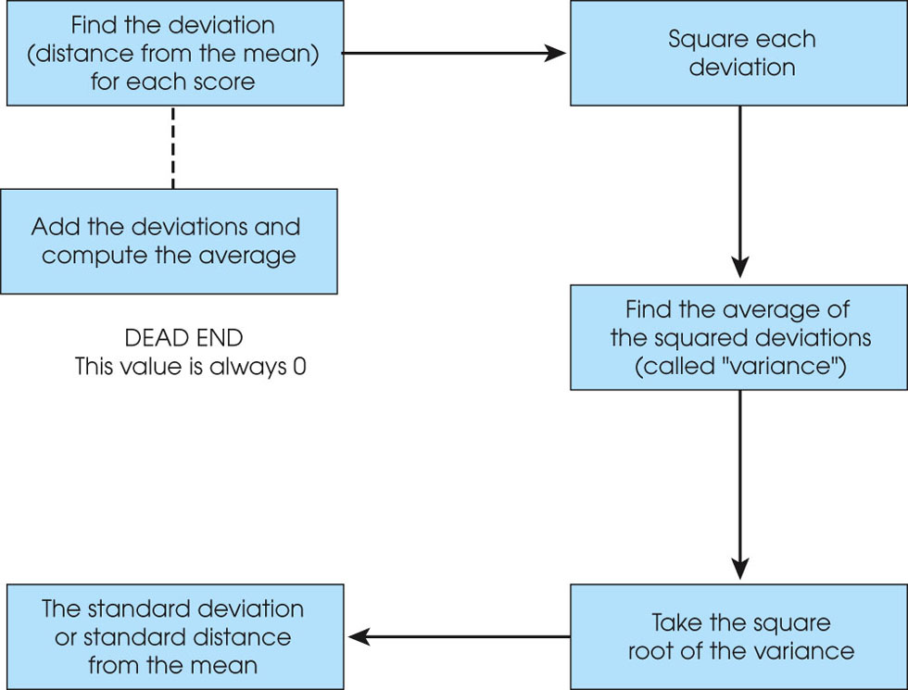
Notes:
Figure 4.3
The calculation of variance and standard deviation.

Slide 52
Properties of the Standard Deviation
If a constant is added to every score in a distribution, the standard deviation will not be changed.
If you visualize the scores in a frequency distribution histogram, then adding a constant will move each score so that the entire distribution is shifted to a new location.
The center of the distribution (the mean) changes, but the standard deviation remains the same.

Slide 53
Properties of the Standard Deviation (cont.)
If each score is multiplied by a constant, the standard deviation will be multiplied by the same constant.
Multiplying by a constant will multiply the distance between scores, and because the standard deviation is a measure of distance, it will also be multiplied.

Slide 54
Descriptive Statistics
Descriptive statistical methods quantitatively describe the main features of data
Main data features
measures of central tendency – represent a ‘center’ around which measurements are distributed
e.g. mean and median
measures of variability – represent the ‘spread’ of the data from the ‘center’
e.g. standard deviation
measures of relative standing – represent the ‘relative position’ of specific measurements in the data
e.g quantiles

Slide 55
Mean
Sum all the numbers and divide by their count
x = (x₁+x₂+ … +x_{n})/n
For the example data
Mean = (2+3+4+5+6)/5
= 4
4 is the ‘center’
The information graphic used here is called a dot diagram
0
1
2
3
4
5
6
7
8
9
10

Slide 56
Median
Data 1
The exact middle value
When count is odd just find the middle value of the sorted data
When count is even find the mean of the middle two values
For example data 1
Median is 4
4 is the ‘center’
For example data 2
Median is (3+4)/2 = 3.5
3.5 is the ‘center’
0
1
2
3
4
5
6
7
8
9
10
Data 2
0
1
2
3
4
5
6
7
8
9
10

Slide 57
Median VS Mean
When data has outliers median is more robust
The blue data point is the outlier in data 2
When data distribution is skewed median is more meaningful
For example data 1
Mean=4 and median=4
For example data 2
Mean=24/5 and median=4
Data 1
0
1
2
3
4
5
6
7
8
9
10
Data 2
0
1
2
3
4
5
6
7
8
9
10

Slide 58
Standard Deviation
Computation steps
Compute mean
Compute each measurement’s deviations from the mean
Square the deviations
Sum the squared deviations
Divide by (count-1)
Compute the square root
σ = √(∑(x_{i}-x)²)/(n-1)
Data 1
0
1
2
3
4
5
6
7
8
9
10
σ
σ
Mean = 4
Deviations: -2, -1, 0, 1, 2
Squared deviations: 4, 1, 0, 1, 4
Sum = 10
Standard deviation = √(10/4) = 1.58

Slide 59
Quartiles
Median is the 2nd quartile
1st quartile is the measurement with 25% measurements smaller and 75% larger – lower quartile (Q1)
3rd quartile is the measurement with 75% measurements smaller and 25% larger – upper quartile (Q3)
Inter quartile range (IQR) is the difference between Q3 and Q1
Q3-Q1
25%
25%
25%
25%
IQR
Q1
Q3

Slide 60
Stem and Leaf Plot
This plot organizes data for easy visual inspection
Min and max values
Data distribution
Unlike descriptive statistics, this plot shows all the data
No information loss
Individual values can be inspected
Structure of the plot
Stem – the digits in the largest place (e.g. tens place)
Leaves – the digits in the smallest place (e.g. ones place)
Leaves are listed to the left of stem separated by ‘|’
Possible to place leaves from another data set to the right of the stem for comparing two data distributions
Data
29, 44, 12, 53, 21, 34, 39, 25, 48, 23, 17, 24, 27, 32, 34, 15, 42, 21, 28, 37
Stem and Leaf Plot
1 | 2 7 5
2 | 9 1 5 3 4 7 1 8
3 | 4 9 2 4 7
4 | 4 8 2
5 | 3

Slide 61
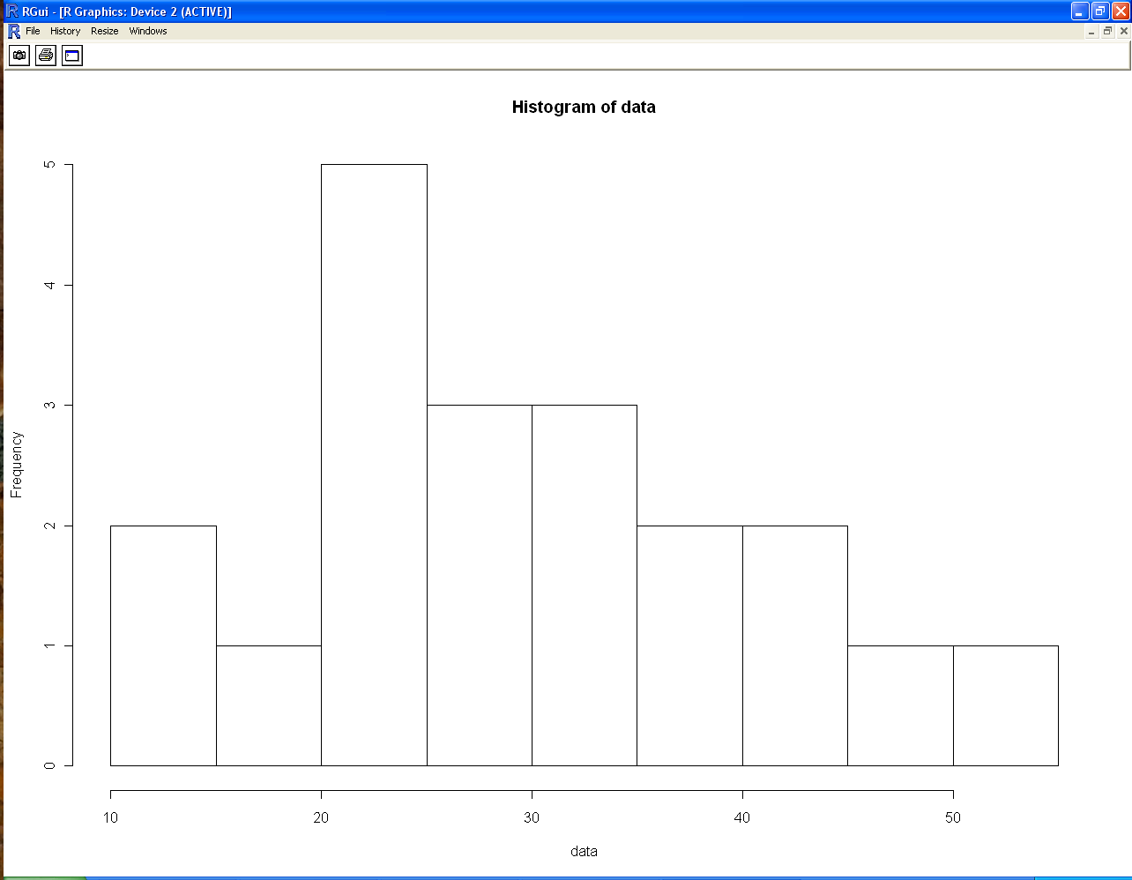
Histogram/Bar Chart
Graphical display of frequency distribution
Counts of data falling in various ranges (bins)
Histogram for numeric data
Bar chart for nominal data
Bin size selection is important
Too small – may show spurious patterns
Too large – may hide important patterns
Several Variations possible
Plot relative frequencies instead of raw frequencies
Make the height of the histogram equal to the ‘relative frequency/width’
Area under the histogram is 1
When observations come from continuous scale histograms can be approximated by continuous curves
Data
29, 44, 12, 53, 21, 34, 39, 25, 48, 23, 17, 24, 27, 32, 34, 15, 42, 21, 28, 37

Slide 62
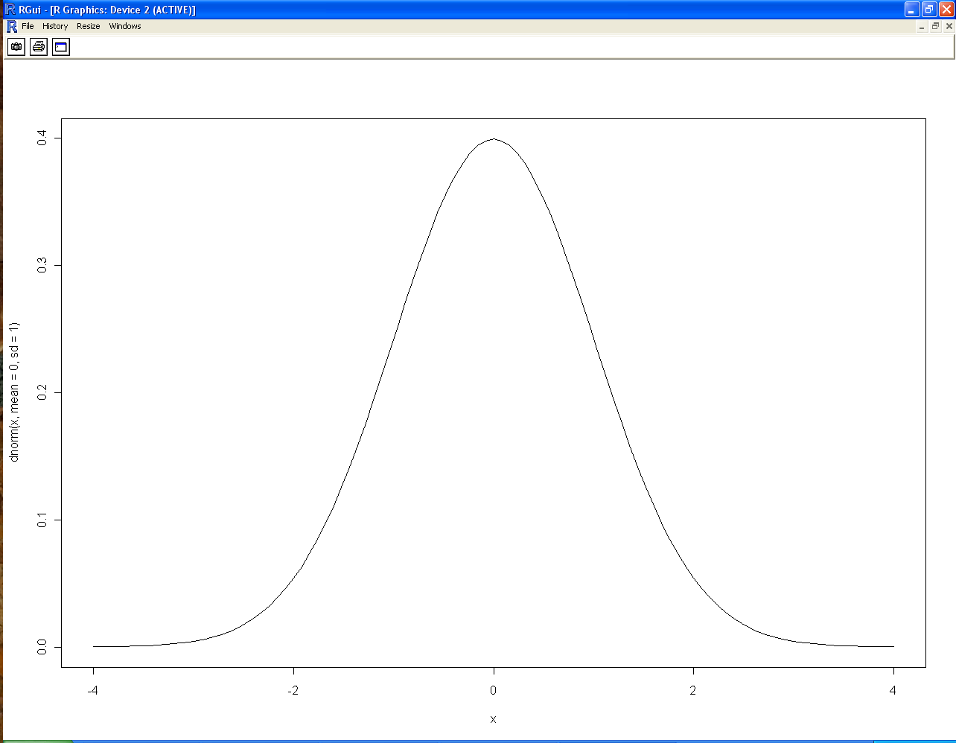
Normal Distribution
Distributions of several data sets are bell shaped
Symmetric distribution
With peak of the bell at the mean, μ of the data
With spread (extent) of the bell defined by the standard deviation, σ of the data
For example, height, weight and IQ scores are normally distributed
The 68-95-99.7% Rule
68% of measurements fall within μ – σ and μ + σ
95% of measurements fall within μ – 2σ and μ + 2σ
99.7% of observations fall within μ – 3σ and μ + 3σ

Slide 63
Standardization
Data sets originate from several sources and there are bound to be differences in measurements
Comparing data from different distributions is hard
Standard deviation of a data set is used as a yardstick for adjusting for such distribution specific differences
Individual measurements are converted into what are called standard measurements called z scores
An individual measurement is expressed in terms of the number of standard deviations, σ it is away from the mean, μ
Z score of x = (x- μ)/ σ
Formula for standardizing attribute values
Z scores are more meaningful for comparison
When different attributes use different ranges of values, we use standardization

Slide 64
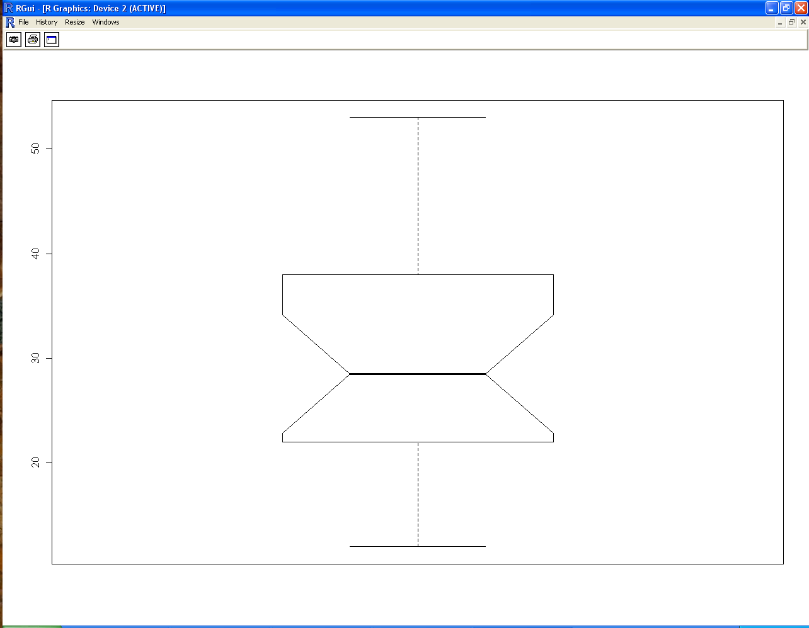
Box Plot
A five value summary plot of data
Minimum, maximum
Median
1st and 3rd quartiles
Often used in conjunction with a histogram in EDA
Structure of the plot
Box represents the IQR (the middle 50% values)
The horizontal line in the box shows the median
Vertical lines extend above and below the box
Ends of vertical lines called whiskers indicate the max and min values
If max and min fall within 1.5*IQR
Shows outliers above/below the whiskers
Data
29, 44, 12, 53, 21, 34, 39, 25, 48, 23, 17, 24, 27, 32, 34, 15, 42, 21, 28, 37

Slide 65
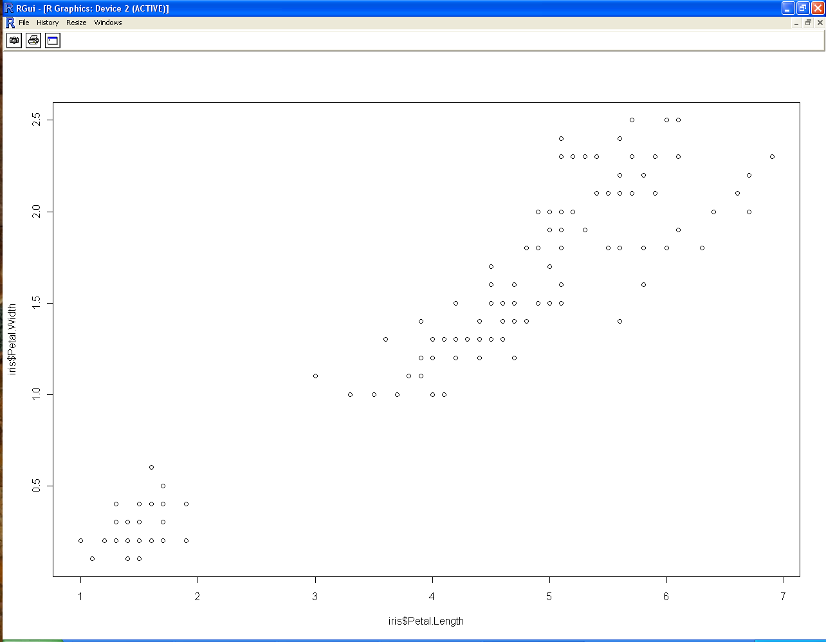
Scatter Plot
Scatter plots are two dimensional graphs with
explanatory attribute plotted on the x-axis
Response attribute plotted on the y-axis
Useful for understanding the relationship between two attributes

Slide 66
The Mean and Standard Deviation as Descriptive Statistics
As a general rule, about 70% of the scores will be within one standard deviation of the mean, and about 95% of the scores will be within a distance of two standard deviations of the mean.

Slide 67
Looking at Data-Distributions
1.1-Displaying Distributions with Graphs

Slide 68
Basic definitions
Data-numbers with a context
Eg. Your friends new baby weighed 10.5 pounds, we know that baby is quite large. But if it is 10.5ounces or 10.5kg, we know that it is impossible-the context makes the number informative
Individuals-objects described in the data(people,animals,things)
Variable-any property/characteristics of an individual(IQ scores of persons)
Distribution-of a variable tells us what values & how often(frequency of a variable)

Slide 69
Types of variables
categorical variable-places an individual into one of several categories(male/female, smoker/nonsmoker)
quantitative variable-takes numerical values for which arithmetic operations such as adding & averaging can be performed(shoe size,age)

Slide 70
How to represent data?
Categorical variables-can use Pie-chart & bar graphs
Eg. make a pie chart/bar graph for distribution of gender
Quantitative variables-can use histogram

Slide 71
Example 1-The color of your car(distribution of the most popular colors for 2005 model luxury cars made in North America
Color | Percent
Silver | 20
White, pearl | 18
Black | 16
Blue | 13
Light brown | 10
Red | 7
Yellow,gold | 6
What percent of vehicles are some other color?
Make a bar graph?
Can we make a pie chart for the given colors?
Would it be correct to make a pie chart if you added an “Other” category?

Slide 72

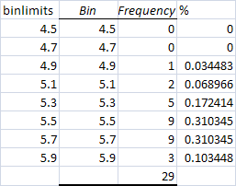
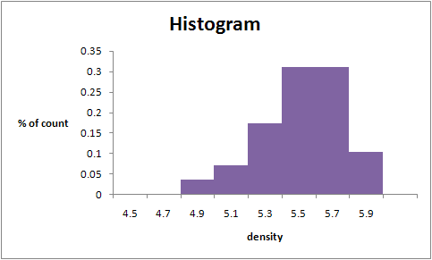
Example 2-The density of the earth (the variable recorded was the density of the earth as multiple of the density of water)

Slide 73
Looking at Data-Distributions
1.2-Describing Distributions with numbers

Slide 74
Mean & Median
Mean is affected by outliers
Median is not affected by outliers
A measure of center alone can be misleading
Solution-need a measure of spread(variability)

Slide 75
Measuring spread
Quartiles
Example 4–Age of 10 students
26,19,20,18,20,19,19,19,19,21
Sort them in ascending order
18,19,19,19,19,19,20,20,21,26
Median =19 (Q₂ )
First quartile=median of the lower half of data(Q₁ )=19
Third quartile=median of the upper half of data(Q₃ )=20

Slide 76
Five-number summary
Min Q₁ Q₂ Q₃ Max
Box plot- Picture of the five number summary. Can be used to compare two distributions
IQR(Inter quartile range)= Q₃ - Q₁
Max
Q₃
IQR
Median(Q₂ )
Q₁
Min

Slide 77
SIMPLE LINEAR CORRELATION
DEFINITION OF CORRELATION
“If two or more quantities vary in sympathy so that movements in one tend to be accompanied by corresponding movements in other(s) then they are said to be correlated.”
Or
“Correlation is an analysis of co-variation between two or more variables.”

Slide 78


Meaning of Correlation Analysis
Correlation is the degree of inter-relatedness among the two or more variables.
Correlation analysis is a process to find out the degree of relationship between two or more variables by applying various statistical tools and techniques.

Slide 79
TYPES OF CORRELATION
The following are different types of correlation:
Positive and Negative Correlation
Simple, Partial and Multiple Correlation
Linear and Non-linear Correlation

Slide 80

Types of correlation
On the basis of degree of correlation
On the basis of
linearity
On the basis of
number of variables
Positive correlation
Simple
correlation
Linear
correlation
Partial correlation
Non – linear
correlation
Negative
correlation
Multiple
correlation

Slide 81





Correlation : On the basis of degree
Positive Correlation
if one variable is increasing and with its impact on average other variable is also increasing that will be positive correlation.
For example :
Income ( Rs.) : 350360 | 370 | 380
Weight ( Kg.) : 30 40 | 50 | 60

Slide 82



Correlation : On the basis of degree
Negative correlation
if one variable is increasing and with its impact on average other variable is also decreasing that will be positive correlation.
For example :
Income ( Rs.) : 350 360 | 370 | 380
Weight ( Kg.) : 80 70 | 60 | 50

Slide 83





Correlation : On the basis of number of variables
Simple correlation
Correlation is said to be simple when only two variables are analyzed.
For example :
Correlation is said to be simple when it is done between demand and supply or we can say income and expenditure etc.

Slide 84
Correlation : On the basis of number of variables
Partial correlation :
When three or more variables are considered for analysis but only two influencing variables are studied and rest influencing variables are kept constant.
For example :
Correlation analysis is done with demand, supply and income. Where income is kept constant.

Slide 85
Correlation : On the basis of number of variables
Multiple correlation :
In case of multiple correlation three or more variables are studied simultaneously.
For example :
Rainfall, production of rice and price of rice are studied simultaneously will be known are multiple correlation.

Slide 86

Correlation : On the basis of linearity
Linear correlation :
If the change in amount of one variable tends to make changes in amount of other variable bearing constant changing ratio it is said to be linear correlation.
For example :
Income ( Rs.) : 350 360 |  | 370 | 380
Weight ( Kg.) : 30 | 40 | 50 | 60

Slide 87


Correlation : On the basis of linearity
Non - Linear correlation :
If the change in amount of one variable tends to make changes in amount of other variable but not bearing constant changing ratio it is said to be non - linear correlation.
For example :
Income ( Rs.) : 320 360 | 410 | 490
Weight ( Kg.) : 21 33 | 49 | 56

Slide 88
Positive and Negative Correlation
The correlation between two variables is said to be positive or direct if an increase (or a decrease) in one variable corresponds to an increase (or a decrease) in the other.
The correlation between two variables is said to be negative or inverse if an increase (or a decrease) corresponds to a decrease (or an increase) in the other.

Slide 89
Simple, Partial and Multiple Correlation
Simple Correlation: It involves the study of only two variables. For example, when we study the correlation between the price and demand of a product, it is a problem of simple correlation.
Partial Correlation: It involves the study of three or more variables, but considers only two variables to be influencing each other. For example, if we consider three variables, namely yield of wheat, amount of rainfall and amount of fertilizers and limit our correlation analysis to yield and rainfall, with the effect of fertilizers removed, it becomes a problem relating to partial correlation only.
Multiple Correlation: It involves the study of three or more variables simultaneously. For example, if we study the relationship between the yield of wheat per acre and both amount of rainfall and the amount of fertilizers used, it becomes a problem relating to multiple correlation.

Slide 90
Linear and Non-linear Correlation
Linear Correlation: The correlation between two variables is said to be linear if the amount of change in one variable tends to bear a constant ratio to the amount of change in other variable.
Non-linear (or Curvilinear): The correlation between two variables is said to be non-linear or curvilinear if the amount of change in one variable does not bear a constant ratio to the amount of change in other variable.

Slide 91
METHODS OF STUDYING CORRELATION
Scatter Diagram Method
Karl Pearson’s Coefficient of Correlation, and
Rank Correlation Method

Slide 92
Scatter Diagram Method
A scatter diagram of the data helps in having a visual idea about the nature of association between two variables. If the points cluster along a straight line, the association between two variables is linear. Further, if the points cluster along a curve, the corresponding association is non-linear or curvilinear. Finally, if the points neither cluster along a straight line nor along a curve, there is absence of any association between the variables.

Slide 93
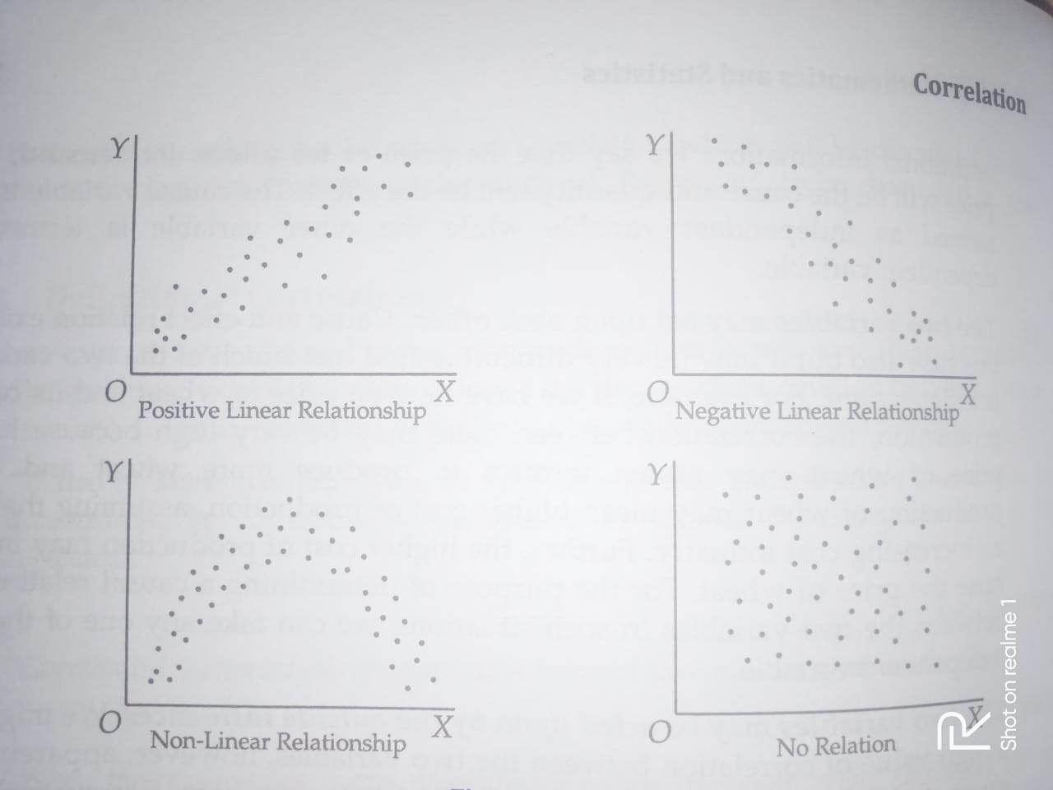

Slide 94
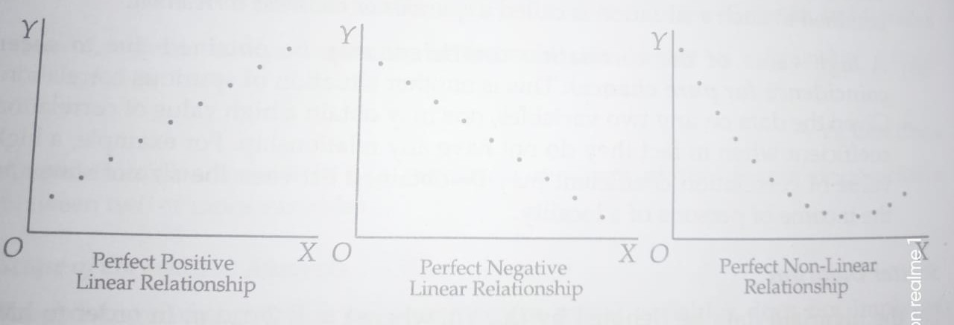

Slide 95
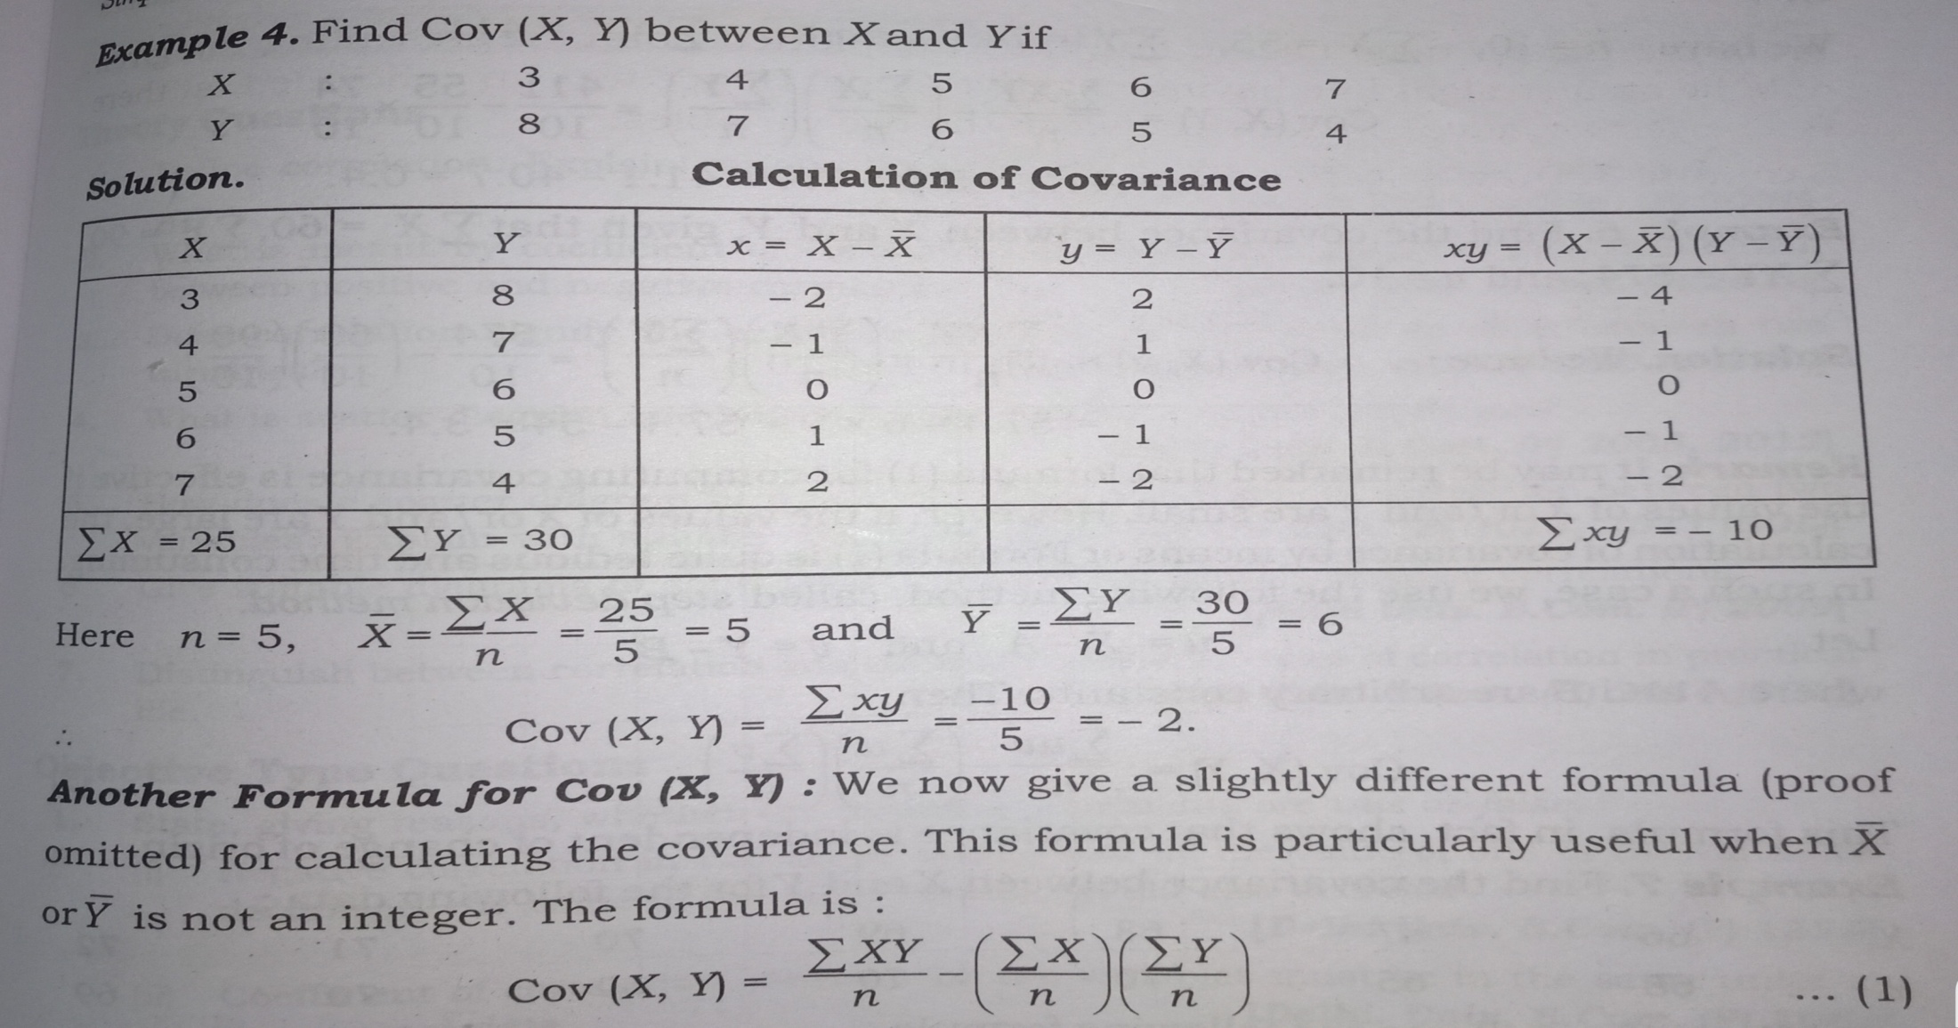
Covariance
The covariance between X and Y, is denoted by Cov (X, Y)

Slide 96




Three Stages to solve correlation problem :
Determination of relationship, if yes, measure it.
Significance of correlation.
Establishing the cause and effect relationship, if any.

Slide 97


Importance of correlation analysis :
Measures the degree of relation i.e. whether it is positive or negative.
Estimating values of variables i.e. if variables are highly correlated then we can find value of variable with the help of given value of variable.

Slide 98

Correlation and Causation
The correlation may be due to pure chance, especially in a small sample.
Both the correlated variables may be influenced by one or more other variables.
Both the variables may be mutually influencing each other so that neither an be designed as the cause and other as effect.

Slide 99


Coefficient of Determination :
Coefficient of determination also helps in interpreting the value of coefficient of correlation. Square of value of correlation
is used to find out the proportionate relationship or dependence of dependent variable on independent variable. For e.g. r= 0.9 then r² = .81 or 81% dependence of dependent variable on independent
variable.
Coefficient of Determination =
Explained variation
Total variance

